Slide 1
Exam 1 Review

Slide 2
Exam 1
Exam 1 on Monday, February 26, 2018
Closed book, closed computers/phones
You are allowed two “cheat pages”, a standard 8.5x11-sized sheet filled on both sides
  Type or write by hand (recommended)

Slide 3
Topics
Reasoning about code
  Forward and backward reasoning, logical conditions, Hoare triples, weakest precondition, rules for assignment, sequence, if-then-else, loops, loop invariants, decrementing functions
Spring 18 CSCI 2600, K. Kuzmin, A Milanova

Slide 4
Forward Reasoning
Forward reasoning simulates the execution of code. Introduces facts as it goes along
  E.g., { x = 1 }
  y = 2*x
  { x = 1 && y = 2 }
  z = x + y
  { x = 1 && y = 2 && z = 3 }
  Collects all facts, often those facts are irrelevant to the goal
Spring 18 CSCI 2600, K. Kuzmin, A Milanova

Slide 5
Backward Reasoning
Backward reasoning “goes backwards”. Starting from a given postcondition, finds the weakest precondition that ensures the postcondition
  E.g., { y < 1 } // Simplify 2y < y+1 into { y < 1 }
  z = y + 1 // Substitute y+1 for z in 2y < z
  { 2*y < z }
  x = 2*y // Substitute rhs 2*y for x in x < z
  { x < z }
  More focused and more useful

Slide 6
Condition Strength
“P is stronger than Q” means “P implies Q”
“P is stronger than Q” means “P guarantees more than Q”
  E.g., x>0 is stronger than x>-1
Fewer values satisfy P than Q
  E.g., fewer values satisfy x>0 than x>-1
Stronger means more specific
Weaker means more general

Slide 7
Condition Strength
Which one is stronger?
x > -10 or x > 0
x > 0 && y = 0 or x > 0 || y = 0
0 ≤ x ≤ 10 or 5 ≤ x ≤ 11 (Neither!)
y Ξ 2 (mod 4) or y is even
x = 10 or x is even

Slide 8
Hoare Triples
A Hoare Triple: { P } code { Q }
  P and Q are logical statements about program values, and code is program code (in our case, Java code)
“{ P } code { Q }” means “if P is true and we execute code, then Q is true afterwards”
  “{ P } code { Q }” is a logical formula, just like “0≤index”
Spring 18 CSCI 2600, K. Kuzmin, A Milanova (modified from slide by Michael Ernst, UW)

Slide 9
Examples of Hoare Triples
{ x>0 } x++ { x>1 } is true
{ x>0 } x++ { x>-1 } is true
{ x≥0 } x++ { x>1 } is false. Why?
{x>0} x++ {x>0} is ??
{x<0} x++ {x<0} is ??
{x=a} if (x < 0) x=-x { x = | a | } is ??
{x=y} x=x+3 {x=y} is ??
Spring 18 CSCI 2600, K. Kuzmin, A Milanova
Notes:
{ x≥0 } x++ { x>1 } is a logical formula, just like “x+y = z” or “1 + 2 = 3”. The meaning of “{ x≥0 } x++ { x>1 }” is “If x>=0 and we execute x++, then x>1 will hold”. But this statement is false because when x=1, x++ will be 1 (and hence x>1 won’t hold).

Slide 10
Rules for Backward Reasoning: Assignment
// precondition: ??
x = expression
// postcondition: Q
Rule: the weakest precondition =
Q, with all occurrences of x in Q replaced by expression
More formally:
wp(“x=expression;”,Q) = Q with all occurrences of x replaced by expression
Notes:
The “weakest precondition” means there exist no condition P’ such that P’ is weaker than the “wp(“x=expression;”, Q)” and P’ ensures Q.

Slide 11
Rules for Backward Reasoning: Sequence
// precondition: ??
S1; // statement
S2; // another statement
// postcondition: Q
Work backwards:
precondition is wp(“S1;S2;”, Q) = wp(“S1;”,wp(“S2;”,Q))
Example:
// precondition: ??
x = 0;
y = x+1;
// postcondition: y>0
// precondition: ??
x = 0;
// postcondition for x=0; same as
// precondition for y=x+1;
y = x+1;
// postcondition y>0
Notes:
Precondition is {true}, which is the weakest preconditions of all. This means the code imposes no restrictions at all.

Slide 12
Rules for If-then-else
Forward reasoning
{ P }
if b
{ P ∧ b }
S1
{ Q1 }
else
{ P ∧ b }
S2
{ Q2 }
{ Q1 ∨ Q2 }
Backward reasoning
{ (b∧wp(“S1”,Q))∨( b∧wp(“S2”,Q)) }
if b
{ wp(“S1”,Q) }
S1
{ Q }
else
{ wp(“S2”,Q) }
S2
{ Q }
{ Q }
Spring 18 CSCI 2600, K. Kuzmin, A Milanova (slide due to Michael Ernst)

Slide 13
Reasoning About Loops by Induction
Partial correctness
  Guess loop invariant
  Prove loop invariant using computation induction
  Loop exit condition (i.e., !b) and loop invariant imply the desired postcondition
Termination
  (Intuitively) Guess “decrementing function” D:
  1) D is bounded, 2) at each iteration D decreases, and 3) D = 0 AND loop invariant, imply loop exit condition (i.e., D = 0 AND loop invariant imply !b)

Slide 14
Example: Partial correctness
i+z = x is our
loop invariant
i=x and z=0 give us that i+z = x holds at 0th iteration of loop // Base case
Assuming that i+z = x holds after k^{th} iteration, we show it holds after (k+1)^{st} iteration // Induction
z_{new} = z + 1 and i_{new} = i – 1 thus
z_{new} + i_{new} = z + 1 + i – 1 = z + i = x
If loop terminated, we know i = 0. Since z+i = x holds, we have x = z
Precondition: x >= 0;
i = x;
z = 0;
while (i != 0) {
z = z+1;
i = i-1;
}
Postcondition: x = z;
Notes:
Invariant: i + z = x

Slide 15
Example: Termination
Precondition: x >= 0;
i = x;
z = 0;
while (i != 0) {
z = z+1;
i = i-1;
}
Postcondition: x = z;
First, prove that i >= 0. Indeed i >= 0 is a loop invariant.
Decrementing function D is i.
1) D is bounded below by 0 (see above).
2) D decreases
3) D = 0 implies i = 0 (loop exit condition).
Notes:
Invariant: i + z = x

Slide 16
Reasoning About Loops
{ P } while (b) S { Q }

Slide 17
Reasoning About Loops
Loop invariant Inv must be such that
P => Inv // Inv holds before loop. Base case
{ Inv && b } S { Inv } // Assuming Inv held after k^{th} iteration and execution took a (k+1)^{st} iteration, then Inv holds after (k+1)^{st} iteration. Induction
(Inv && !b) => Q // The exit condition !b and loop invariant Inv must imply postcondition
Decrementing function D must be such that
D is bounded
D decreases every time we go through the loop
(D = 0 && Inv) => !b

Slide 18
Topics
Specifications
  Benefits of specifications, PoS specification convention, specification style, specification strength (stronger vs. weaker specifications), comparing specifications via logical formulas, converting PoS specifications into logical formulas
Spring 18 CSCI 2600, K. Kuzmin, A Milanova

Slide 19
Specifications
A specification consists of a precondition and a postcondition
  Precondition: conditions that hold before method executes
  Postcondition: conditions that hold after method finished execution (if precondition held!)
Notes:
conditions: constraints on values
1. From now on, I will use the term “method” which is common Java terminology, as opposed to function, the preferred nomenclature in C++.

Slide 20
Specifications
A specification is a contract between a method and its caller
  Obligations of the method (implementation of specification): agrees to provide postcondition if precondition held!
  Obligations of the caller (user of specification): agrees to meet the precondition and not expect more than postcondition promised
Notes:
conditions: constraints on values
1. From now on, I will use the term “method” which is common Java terminology, as opposed to function, the preferred nomenclature in C++.

Slide 21
Example Specification
Precondition: len ≥ 1 && arr.length = len
Postcondition: returns arr[0]+…+arr[arr.length-1]
double sum(int[] arr, int len) {
double sum = arr[0];
int i = 1;
while (i < len) {
sum = sum + arr[i];
i = i+1;
}
return sum;
}
For our purposes, we will be writing
specifications that are a bit less formal
than this example. Mathematical rigor is
welcome, but not always necessary.
Spring 18 CSCI 2600, K. Kuzmin, A Milanova

Slide 22
Benefits of Specifications
Precisely documents method behavior
  Imagine if you had to read the code of the Java libraries to figure what they do!
  An abstraction --- abstracts away unnecessary detail
Promotes modularity
Enables reasoning about correctness
  Through testing and/or verification
Spring 18 CSCI 2600, K. Kuzmin, A Milanova

Slide 23
PoS Specifications
Specification convention due to Michael Ernst
The precondition
  requires: clause spells out constraints on client
The postcondition
  modifies: lists objects (typically parameters) that may be modified by the method. Any object not listed under this clause is guaranteed untouched
  throws: lists possible exceptions
  effects: describes final state of modified objects
  returns: describes return value
Notes:
More concise and precise!

Slide 24
Example
static List<Integer> listAdd(List<Integer> lst1,
List<Integer> lst2)
requires: lst1, lst2 are non-null.
lst1 and lst2 are same size.
modifies: none
effects: none
returns: a new list of the same size, whose i-the element is the
sum of the i-the elements of lst1 and lst2
static List<Integer> listAdd(List<Integer> lst1,
List<Integer> lst2) {
List<Integer> res = new ArrayList<Integer>();
for (int i = 0; i < lst1.size(); i++)
res.add(lst1.get(i) + lst2.get(i));
return res;
}
Spring 18 CSCI 2600, K. Kuzmin, A Milanova (due to Michael Ernst)
Notes:
Lesson in Java

Slide 25
Another Example
static void listAdd2(List<Integer> lst1,
List<Integer> lst2)
requires: lst1, lst2 are non-null.
lst1 and lst2 are same size.
modifies: lst1
effects: i-the element of lst1 is replaced with the sum of i-th
elements of lst1 and lst2
returns: none
static void listAdd(List<Integer> lst1,
List<Integer> lst2) {
for (int i = 0; i < lst1.size(); i++) {
lst1.set(i,lst1.get(i) + lst2.get(i));
}
}
Spring 18 CSCI 2600, K. Kuzmin, A Milanova (due to Michael Ernst)
Notes:
Note autoboxing and unboxing in Java.

Slide 26
Specification Style
A method is called for its side effects (effects clause) or its return value (returns clause)
  It is bad style to have both effects and return
  There are exceptions
    E.g., HashMap.put returns the previous value
Main point of spec is to be helpful
  Being overly formal does not help
  Being too informal does not help either
If spec turns too complex: redesign. Better to simplify code than document complexity!

Slide 27
What’s Wrong?
static void uniquefy(List<Integer> lst)
requires: ?
modifies: ?
effects: ?
returns: ?
static void uniquefy(List<Integer> lst) {
for (int i = 0; i < lst.size()-1; i++)
if (lst.get(i) == lst.get(i+1))
lst.remove(i);
}
Spring 18 CSCI 2600, K. Kuzmin, A Milanova (due to Michael Ernst)

Slide 28
Specification Strength
“A is stronger than B” means
  For every implementation I
    “I satisfies A” implies “I satisfies B”
    The opposite is not necessarily true
  For every client C
    “C works with B” implies “C works with A”
    The opposite is not necessarily true
Principle of substitutability:
  A stronger spec can always be substituted for a weaker one
Notes:
A weaker specification is easier to satisfy! And thus implement…
A stronger specification is easier to use by clients.

Slide 29
Why Care About Specification Strength?
Because of substitutability!
Principle of substitutability
  A stronger specification can always be substituted for a weaker one
  I.e., an implementation that conforms to a stronger specification can be used in a client that expects a weaker specification
Spring 18 CSCI 2600, K. Kuzmin, A Milanova

Slide 30
Substitutability
Substitutability guarantees correct software updates, correct class hierarchies
Client code: X x; … x.foo(index);
  Client is “polymorphic”: written against X, but it is expected to work with any subclass of X
  A subclass of X, say Y, may have its own implementation of foo, Y.foo(int). Client must work correctly with Y.foo(int!
If spec of Y.foo(int) is stronger than that of X.foo(int) then we can safely substitute Y.foo(int) for X.foo(int)!

Slide 31
Strengthening and Weakening Specification
Strengthen a specification
  Require less of client: fewer conditions in requires clause AND/OR
  Promise more to client: effects, modifies, returns
Weaken a specification
  Require more of client: add conditions to requires
  AND/OR
  Promise less to client: effects, modifies, returns clauses are weaker, thus easier to satisfy in code

Slide 32
Comparing by Logical Formulas
(I satisfies specification A) is a logical formula: P_{A} => Q_{A}
(P_{A} is the precondition of A, Q_{A} is the postcondition of A)
Spec A is stronger than spec B if and only if
for each implementation I, (I satisfies A)=>(I satisfies B)
which is equivalent to A => B
A is stronger than B iff (P_{A} => Q_{A}) => (P_{B} => Q_{B})
Recall from FoCS and/or Intro to Logic: p => q Ξ !p V q
Spring 18 CSCI 2600, K. Kuzmin, A Milanova
Notes:
Comparison using logical formulas is precise but can be difficult to carry out.
It is often difficult to express all preconditions and postconditions with precise logical formulas!

Slide 33

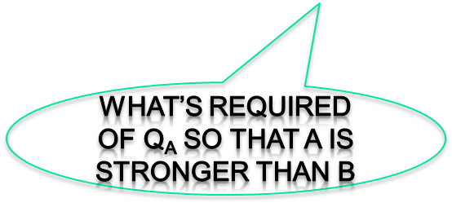
Comparing by Logical Formulas
if and only if
[ P_{B} => (Q_{B} || P_{A}) ] && [ ( P_{B} && Q_{A} ) => Q_{B} ]
A is stronger than B if and only if
P_{B} => Q_{B} is true trivially or P_{B} implies P_{A} AND
Q_{A} together with P_{B} imply Q_{B} (i.e., for the inputs permitted by P_{B}, Q_{B} holds)
P_{B} => P_{A} && Q_{A} => Q_{B} implies A is stronger than B

Slide 34
Exercise: Order by Strength
Spec A: requires: a non-negative int argument
returns: an int in [1..10]
Spec B: requires: int argument
returns: an int in [2..5]
Spec C: requires: true
returns: an int in [2..5]
Spec D: requires: an int in [1..10]
returns: an int in [1..20]
Spring 18 CSCI 2600, K. Kuzmin, A Milanova
Notes:
C is stronger than B is stronger than A is stronger than D.

Slide 35
Converting PoS Specs into Logical Formulas
PoS specification
requires: R
modifies: M
effects: E // absorbs throws, returns and effects
Spec is equivalent to the following logical formula:
R => ( E && (nothing but M is modified) )
Step 1: absorb throws and returns into effects E
Step 2: write R => ( E && (nothing but M is modified) )
Spring 18 CSCI 2600, K. Kuzmin, A Milanova (slide modified from slides by Michael Ernst)

Slide 36
Convert Spec to Formula, step 1: absorb throws and returns into effects
set from java.util.ArrayList<T>
T set(int index, T element)
requires: true
modifies: this[index]
effects: this_{post}[index] = element
throws: IndexOutOfBoundsException if index < 0 || index ≥ size
returns: this_{pre}[index]
Absorb effects, returns and throws into new effects:
if index < 0 || index ≥ size then
throws IndexOutOfBoundsException
else this_{post}[index] = element and returns this_{pre}[index]
Spring 18 CSCI 2600, K. Kuzmin, A Milanova (slide modified from slides by Michael Ernst)

Slide 37
Convert Spec to Formula, step 2: Convert into Formula
set from java.util.ArrayList<T>
T set(int index, T element)
requires: true
modifies: this[index]
effects: if index < 0 || index ≥ size then
throws IndexOutOfBoundsException
else
this_{post}[index] = element and returns this_{pre}[index]
Denote effects expression by E. Resulting formula is:
true => (E ∧ (foreach i ≠ index, this_{post}[i] = this_{pre}[i]))
Spring 18 CSCI 2600, K. Kuzmin, A Milanova (slide modified from slides by Michael Ernst)

Slide 38
Topics
ADTs
  Benefits of ADT methodology, Specifying ADTs, Rep invariants, Representation exposure, Checking rep invariants, Abstraction functions
Spring 18 CSCI 2600, K. Kuzmin, A Milanova

Slide 39
ADTs
Abstract Data Type (ADT): higher-level data abstraction
  The ADT is operations + object
  A specification mechanism
  A way of thinking about programs and design
Spring 18 CSCI 2600, K. Kuzmin, A Milanova (slide based on slide by Michael Ernst)
Notes:
MORE HERE!

Slide 40
An ADT Is a Set of Operations
Operations operate on data representation
ADT abstracts from organization to meaning of data
ADT abstracts from structure to use
Data representation does not matter!
Instead, think of a type as a set of operations: create, x(), y(), r(), theta().
Force clients to call operations to access data
class Roint {
_x0016_ float x, y;
}
class Point {
_x0016_ float r, theta;
}
Spring 18 CSCI 2600, K. Kuzmin, A Milanova (slide modified from material by Michael Ernst)

Slide 41
Specifying an ADT
immutable mutable
class TypeName class TypeName
1. overview 1. overview
2. abstract fields 2. abstract fields
3. creators 3. creators
4. observers 4. observers
5. producers 5. producers (rare!)
6. mutators 6. mutators
Spring 18 CSCI 2600, K. Kuzmin, A Milanova (slide by Michael Ernst)
Notes:
We will talk about abstract fields (aka specification fields) next time.

Slide 42
Connecting Implementation to Specification
Representation invariant: Object → boolean
  Indicates whether data representation is well-formed. Only well-formed representations are meaningful
  Defines the set of valid values
Abstraction function: Object → abstract value
  What the data structure really means
    E.g., array [2, 3, -1] represents –x² + 3x + 2
  How the data structure is to be interpreted
Spring 18 CSCI 2600, K. Kuzmin, A Milanova (based on slides by Michael Ernst)
Notes:
But how do we know that our implementation is correct?

Slide 43
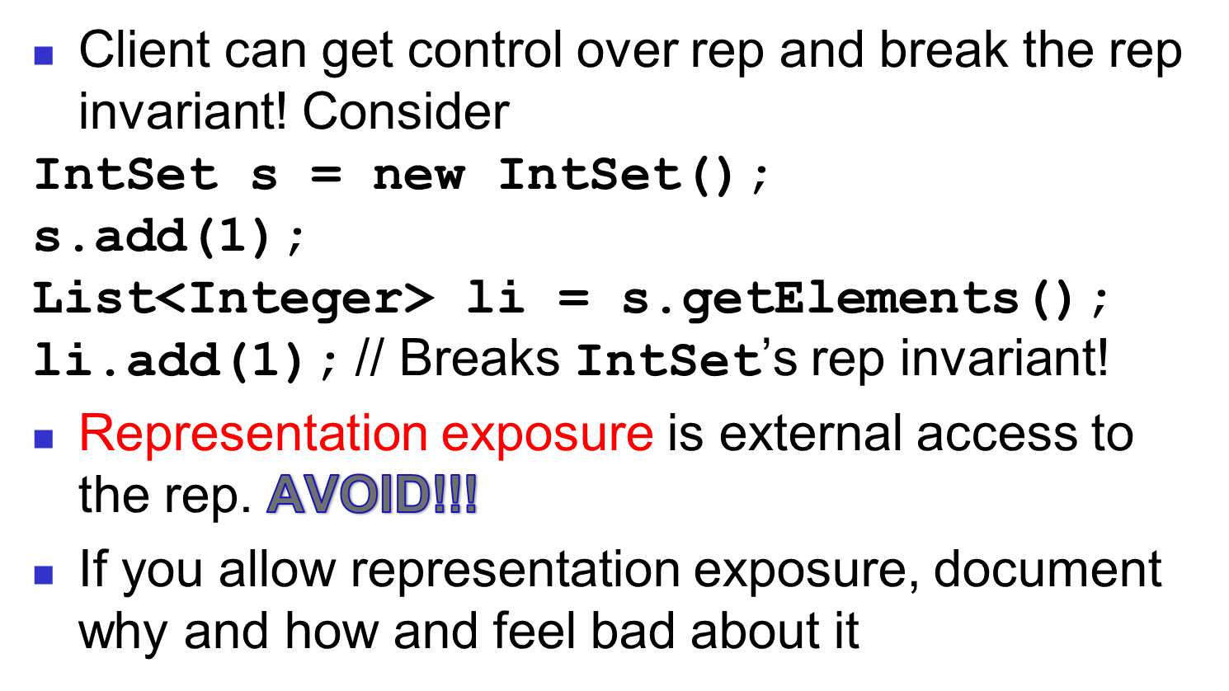
Representation Exposure

Slide 44
Representation Exposure
Make a copy on the way out:
public List<Integer> getElements() {
return new ArrayList<Integer>(data);
}
Mutating a copy does not affect IntSet’s rep
IntSet s = new IntSet();
s.add(1);
List<Integer> li = s.getElements();
li.add(1); //mutates new copy, not IntSet’s rep
Spring 18 CSCI 2600, K. Kuzmin, A Milanova

Slide 45
Representation Exposure
Make a copy on the way in too:
public IntSet(ArrayList<Integer> elts) {
data = new ArrayList<Integer>(elts);
…
}
Why?
Spring 18 CSCI 2600, K. Kuzmin, A Milanova

Slide 46
Abstraction Function
Abstraction function allows us to reason about correctness of the implementation
_x0016_
Abstract operation:
_x0016_
Abstract value
Abstract value’
AF:
AF:
Concrete operation
(i.e., our implementation
of operation):
_x0016_
_x0016_
Concrete object
Concrete object’
Spring 18 CSCI 2600, K. Kuzmin, A Milanova

Slide 47
IntSet Example
abstract remove(1):
this – { 1 }
_x0016_
_x0016_
{ 1,2,3 }
{ 2,3 }
AF:
AF:
Concrete remove(1)
_x0016_
_x0016_
[2,1,1,2,3]
[2,2,3]
Creating concrete object:
Establish rep invariant
Establish abstraction function
After every operations:
Maintains rep invariant
Maintains abstraction function
Spring 18 CSCI 2600, K. Kuzmin, A Milanova
Notes:
If we take a concrete object, apply AF, get Abstract value.

